Slide 1

Electronic Sales
Brand v Brand

Slide 2
Brand specific
Should we focus on one brand?
Is one product better?
Who is buying?

Slide 3
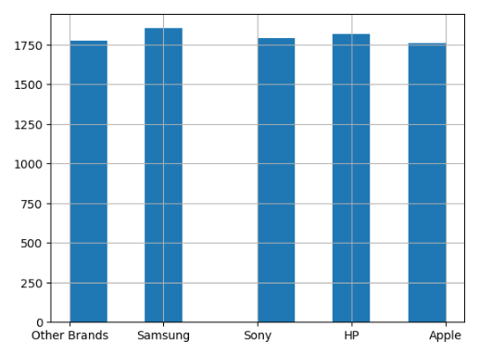
Brand options
Samsung
Sony
HP
Apple
Other Brands

Slide 4
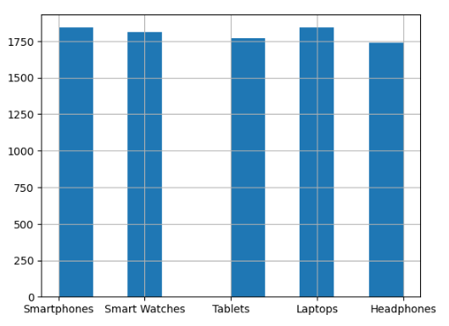
Product options
Smartphones
Smart Watches
Tablets
Laptops
Headphones

Slide 5
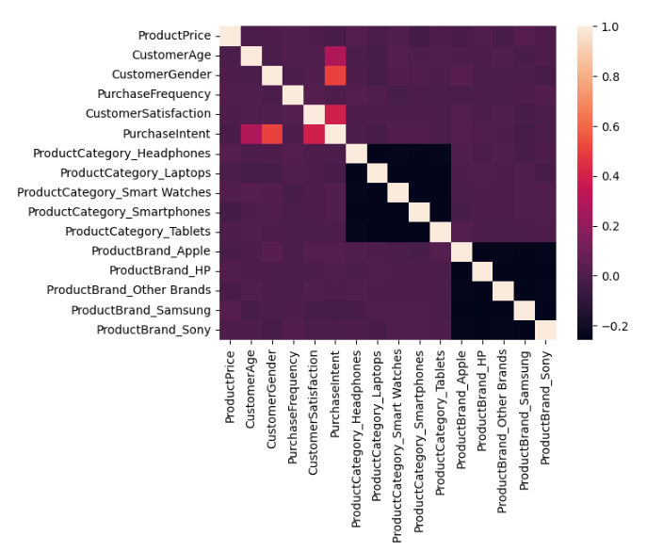
Who is buying?
Everyone
No formal correlation

Slide 6

Conclusion
Variety is the best bet

